Slide 2
Airlines Dataset
Presented by Meenakshi Vaidhiyanathan Pooja Nagaraju

Slide 3
Introduction:
The aim of this project is to build a classification machine learning model prioritizing the satisfaction of the customer. We have explored the details of the airlines dataset to discover patterns and and correlations that significantly influence customer satisfaction levels. The aviation Industry generates large amounts of data daily which reflects on various features of the journey. Prioritizing Customer Satisfaction is an approach for airlines to retain loyalty, attract new customers and succeed in a competitive market. Accompany us on this journey as we navigate through the dataset, explore its complexities and display insights that prioritize customer satisfaction.

Slide 4
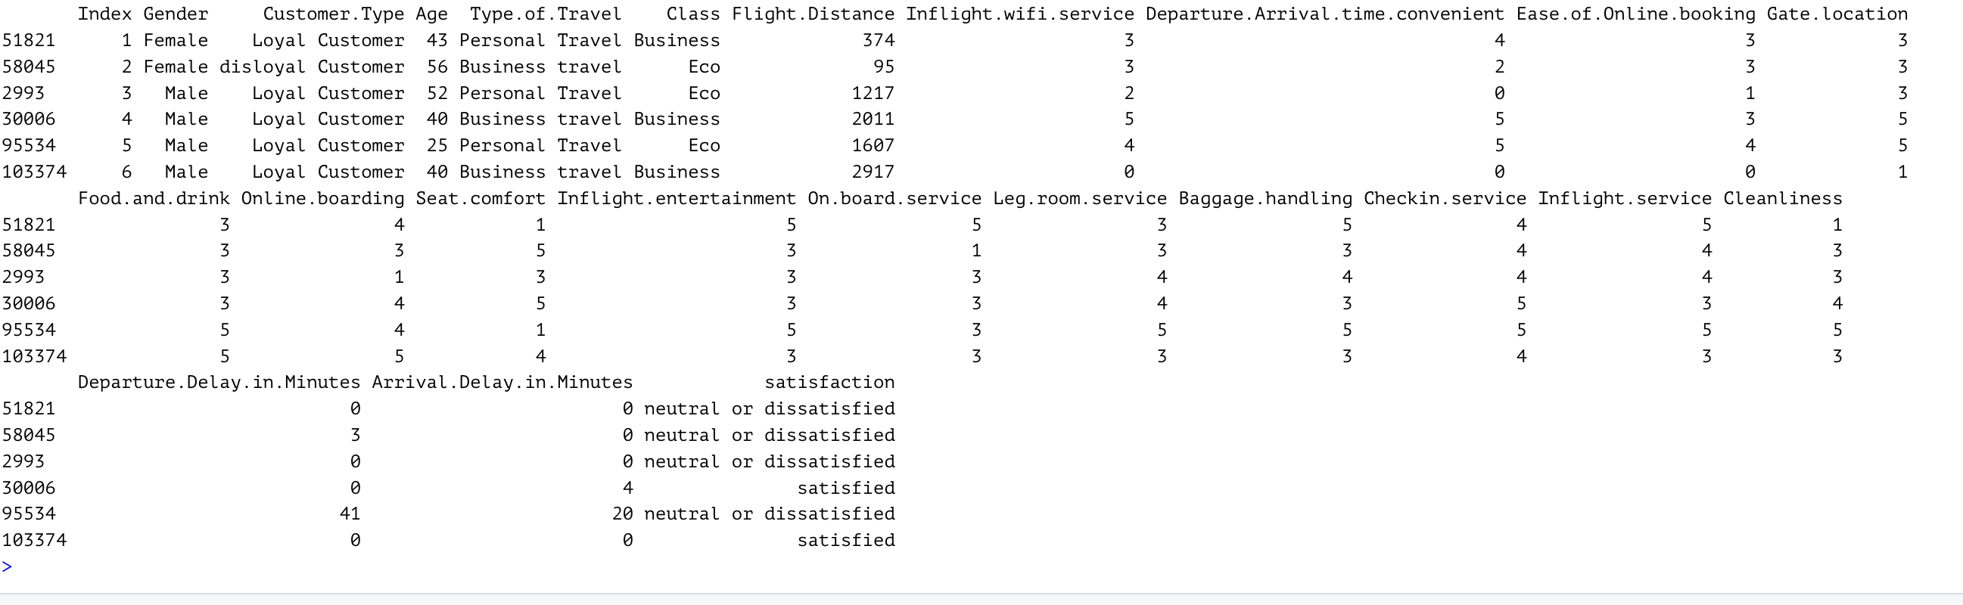
Dataset Overview:

Slide 5
Flowchart of methodologies:
1
2
Descriptive statistics
3
Feature selection
Project goal
4
Data Partition into training and testing data
5
Machine Learning models
6
Conclusion

Slide 6
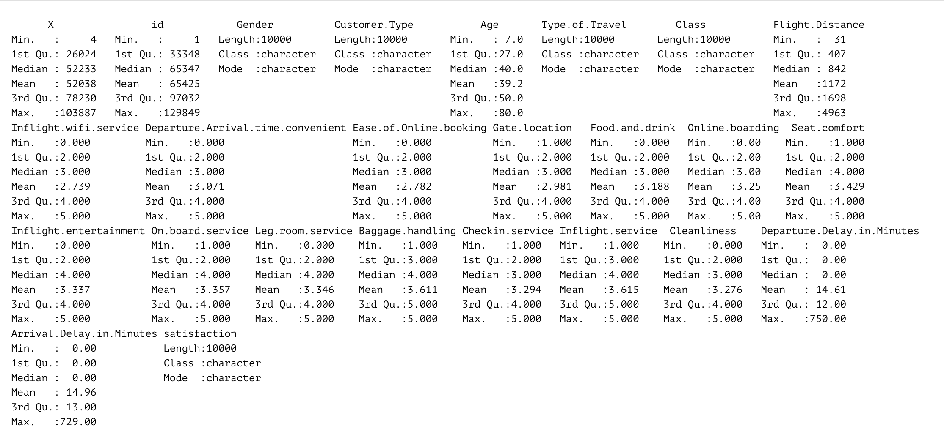
Descriptive Statistics:
Missing Values : We identified a total of 310 missing values within the dataset, constituting less than 5% of the total observations. we decided to drop these rows to ensure the integrity and accuracy of our analysis.
Summary of the Airlines Dataset:

Slide 7
Descriptive statistics continued
Mode
Age: 39
Flight Distance : 337
IQR
Age: 23
Flight Distance : 1291.5
Sd
Age : 14.95
Flight Distance : 986.90

Slide 8
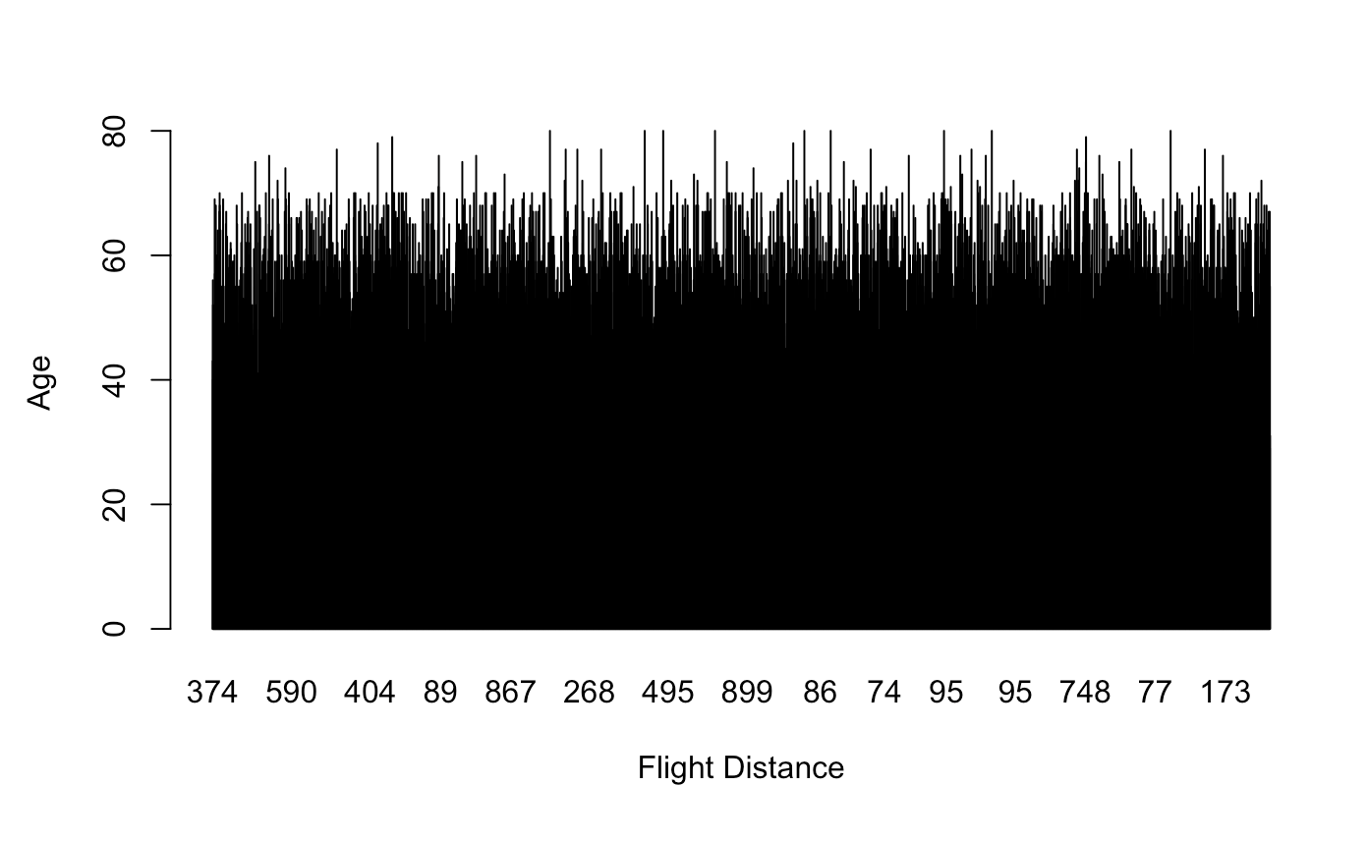
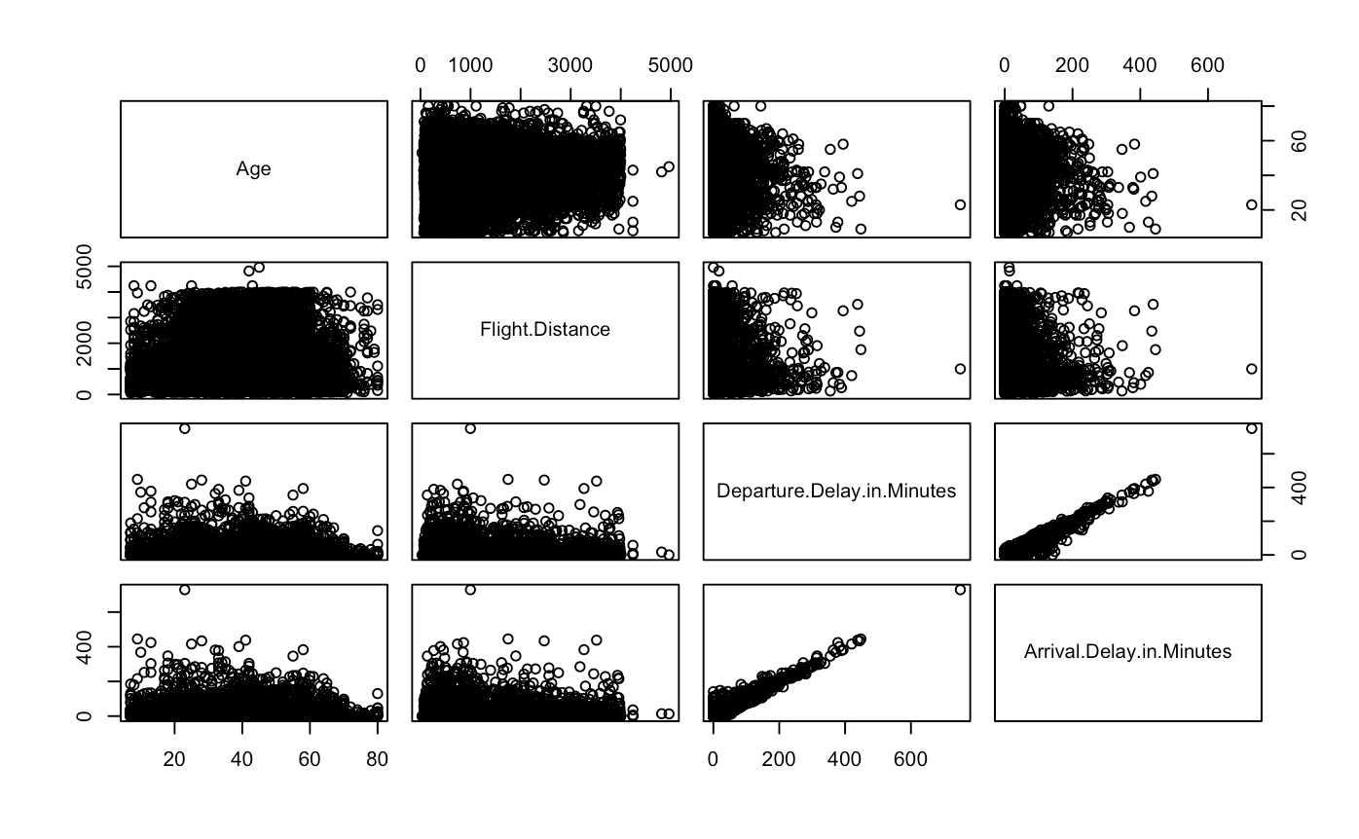
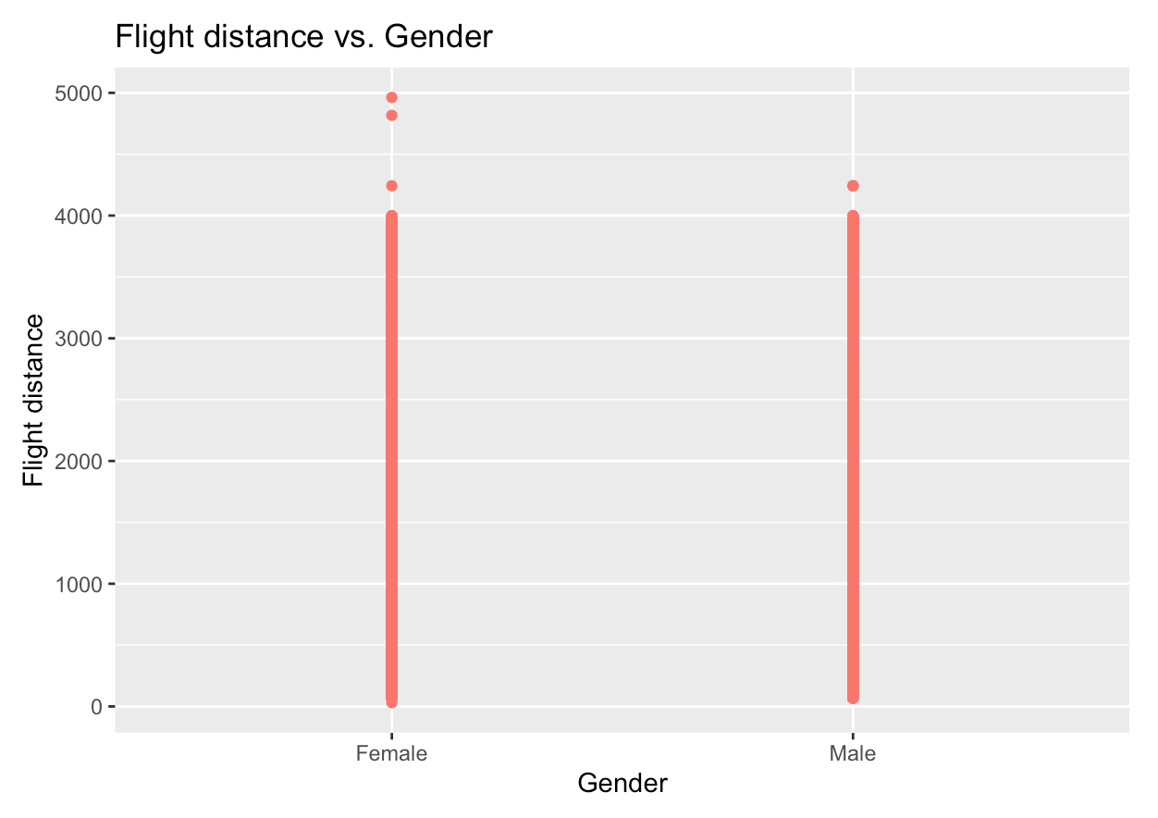
Barplot for Age vs Flight distance
Pairwise correlation between numerical variables

Slide 9
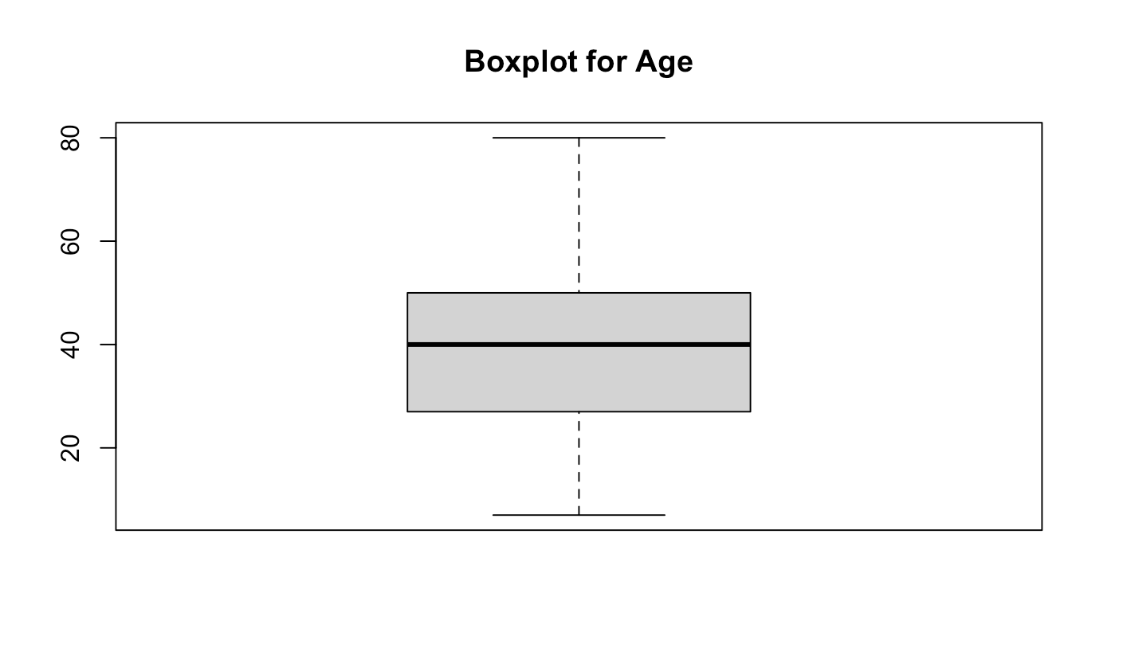
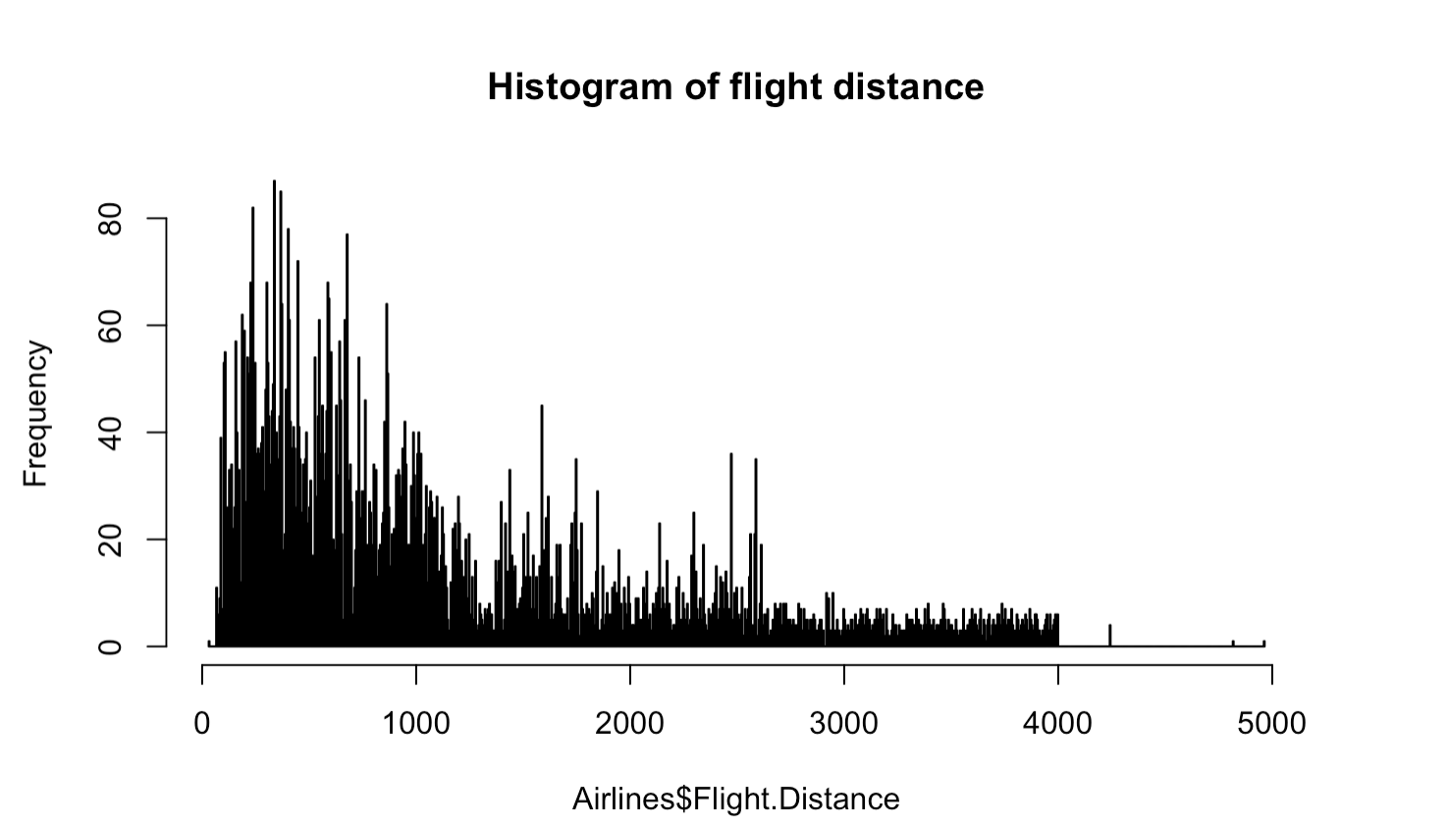
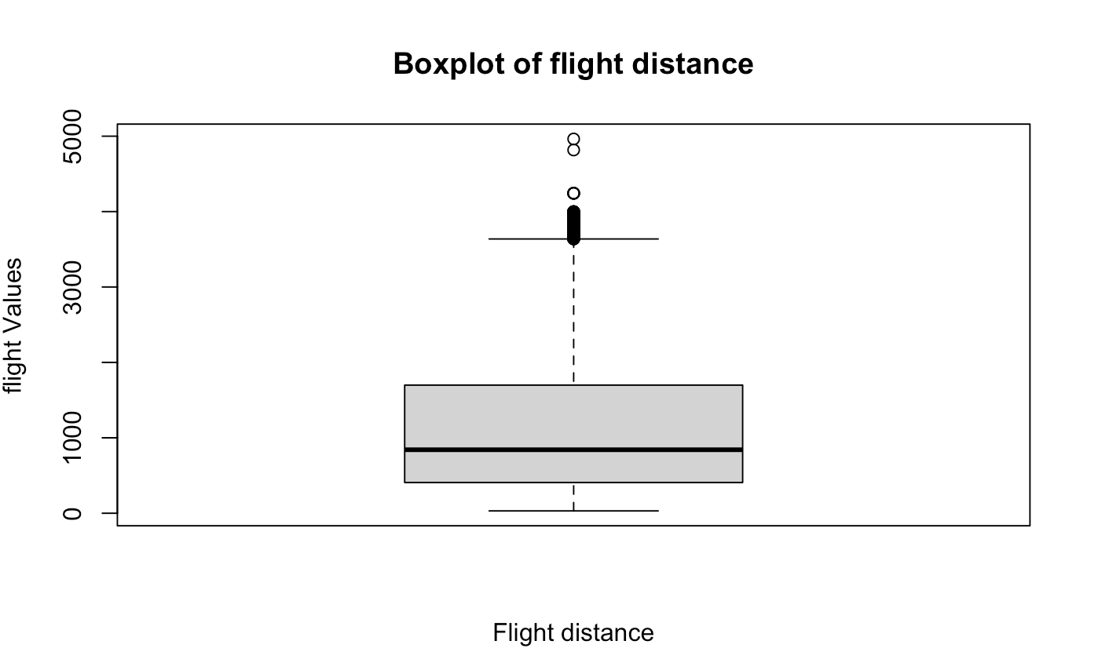

Slide 10
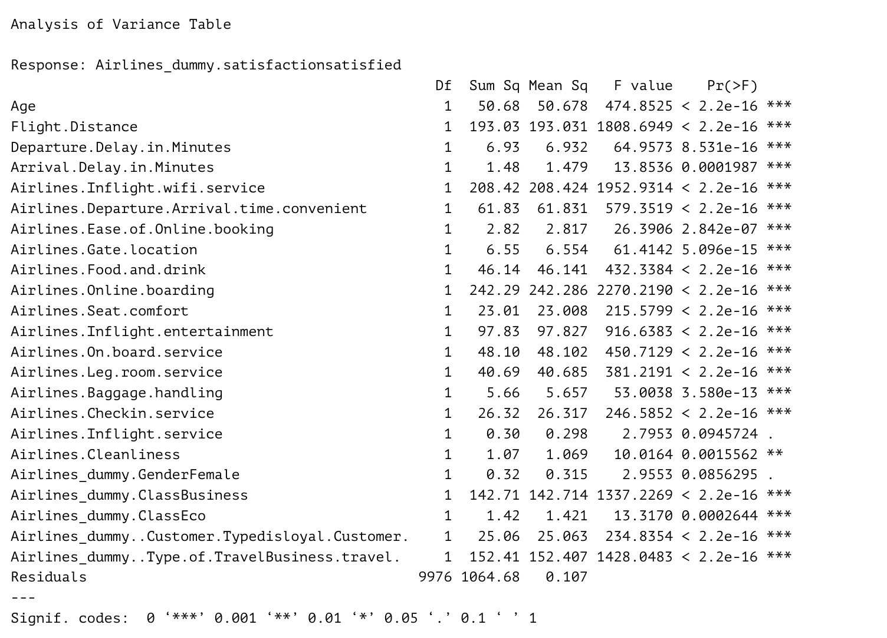
Feature Selection:
Analysis Of Variance :

Slide 11
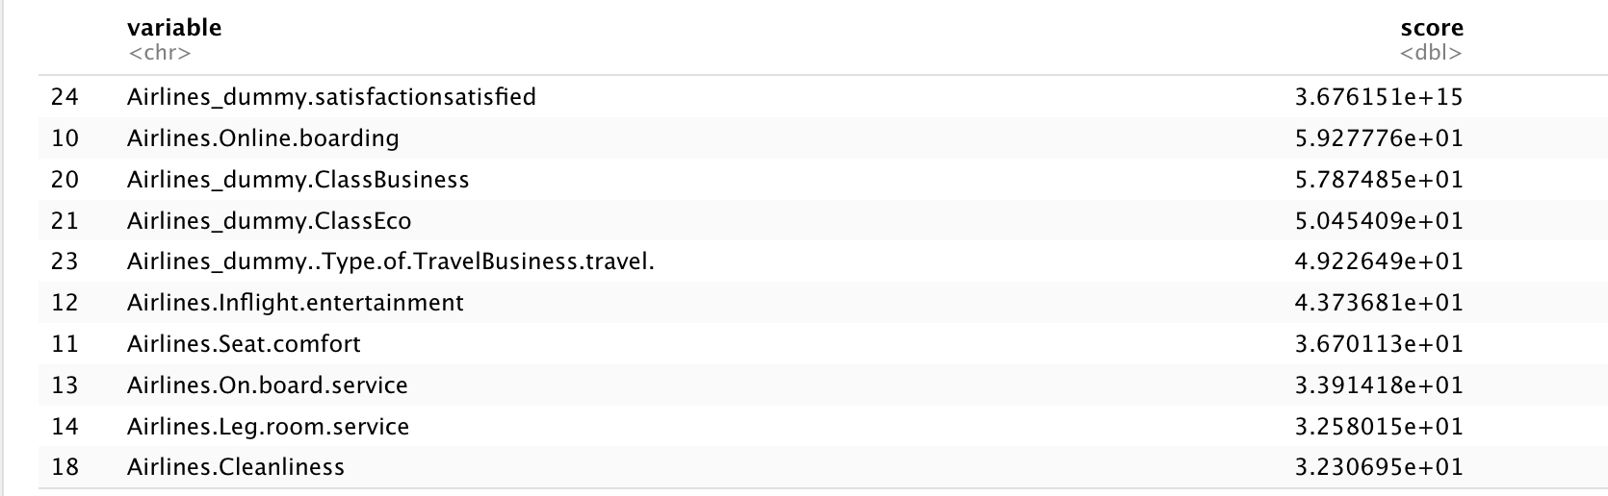
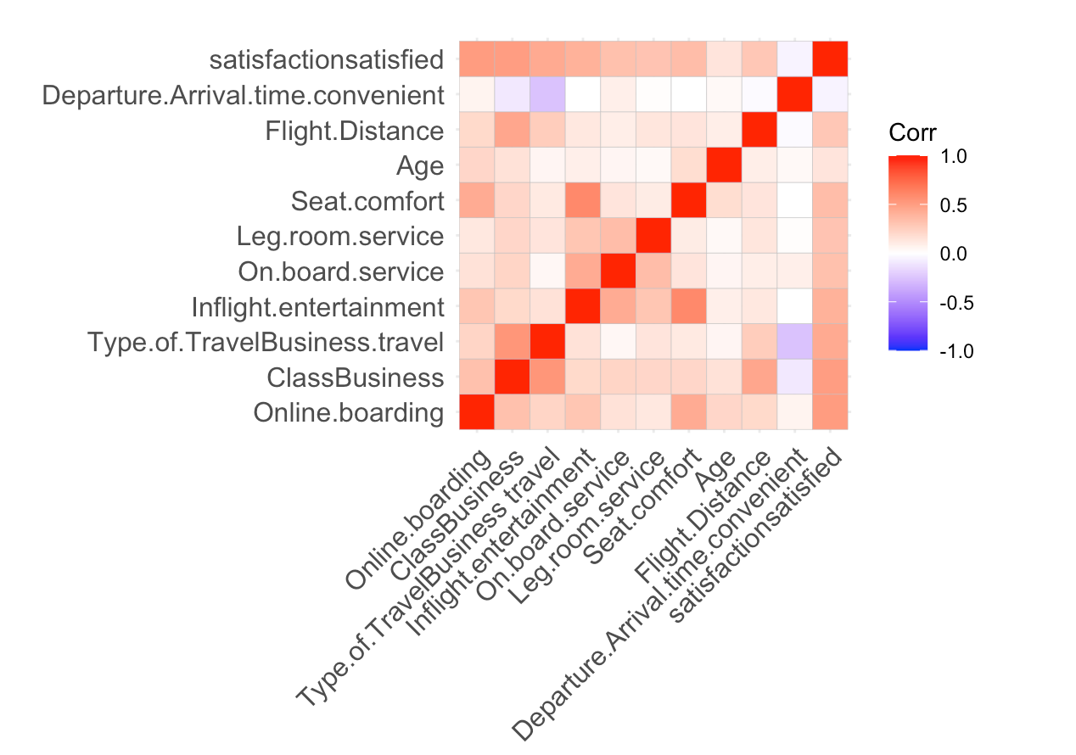
ROC Scoring Method And correlation matrix

Slide 12
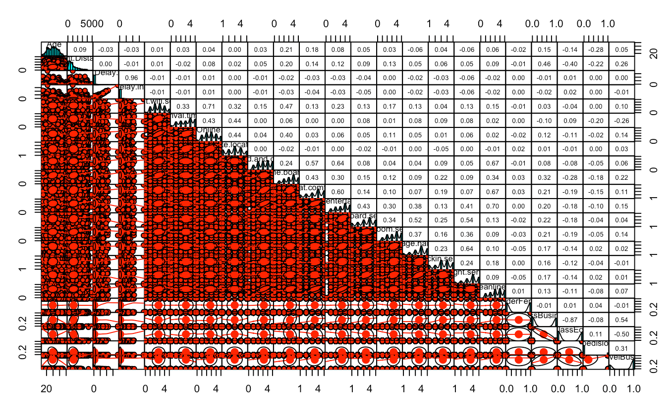
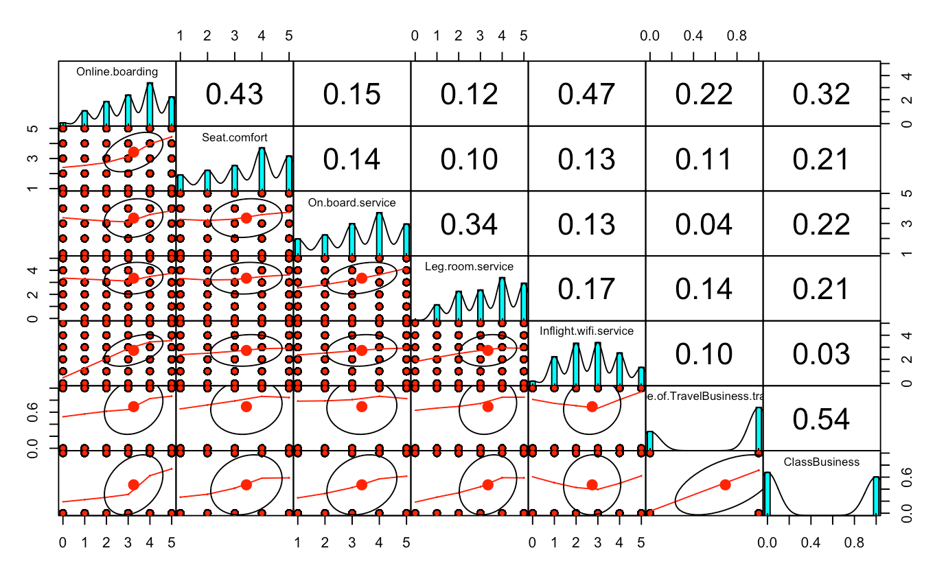
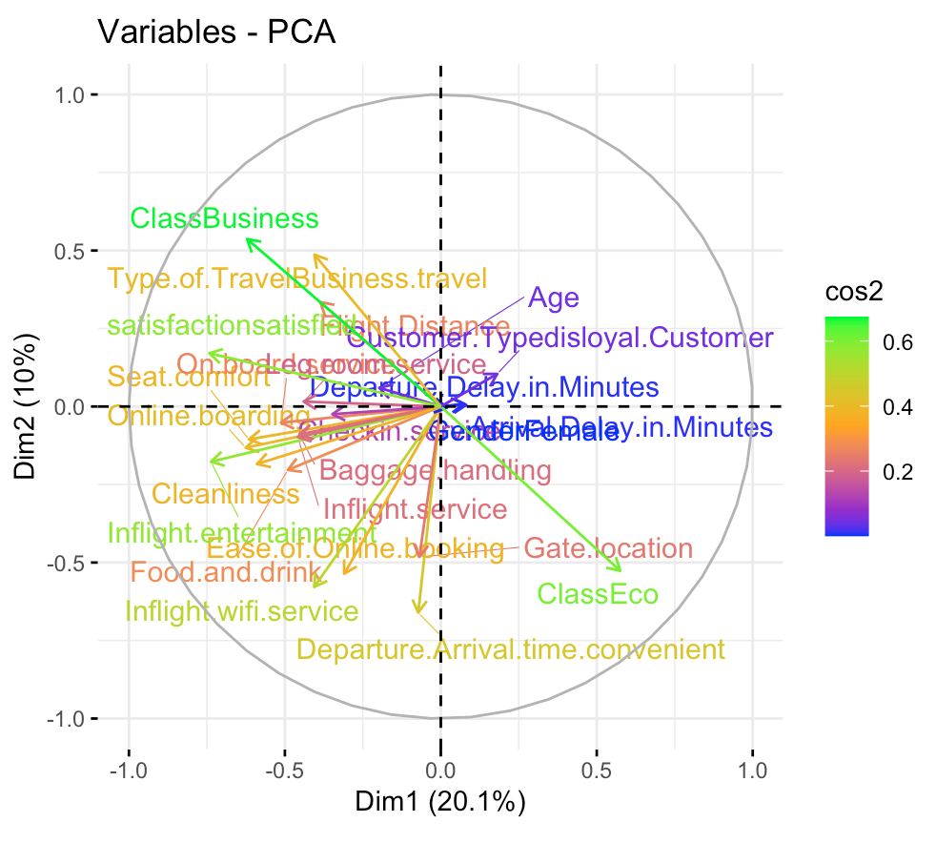
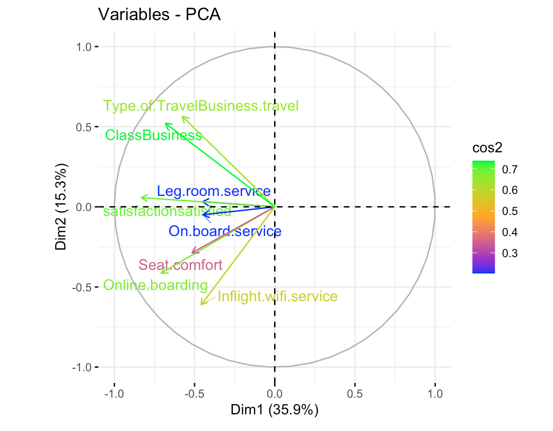
Before Feature Selection
After Feature Selection

Slide 13
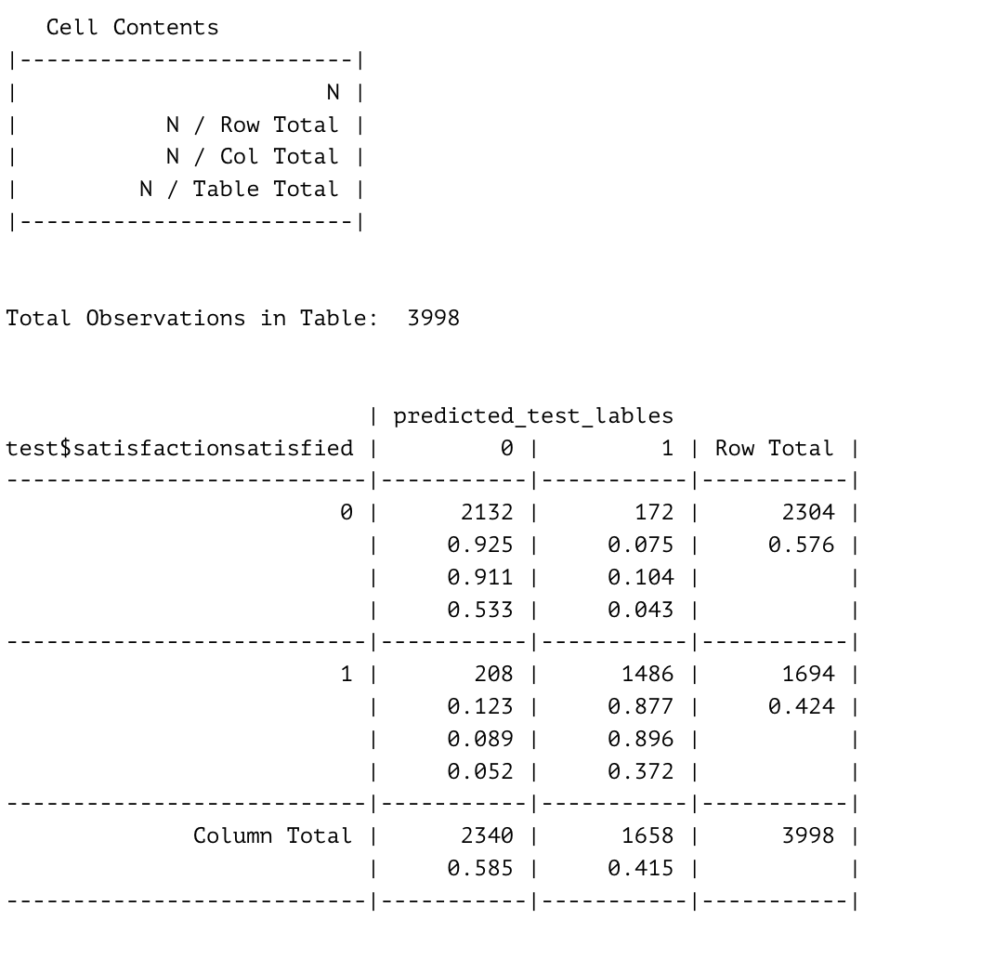
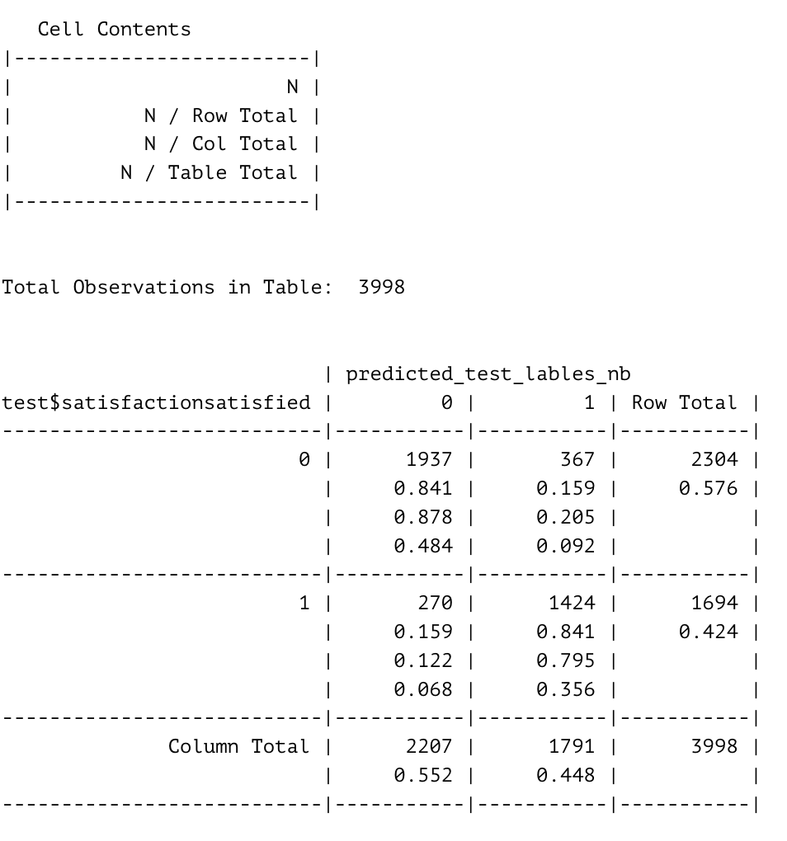
K-NN
Naïve Bayes

Slide 14
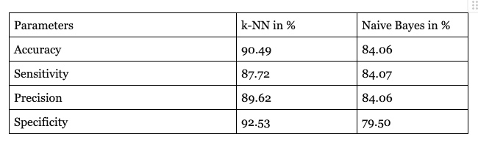
Comparison between k-NN Classification and Naïve Bayes machine learning model

Slide 15
Thank You!

